Slide 1
C Programming
Presented By:
Asst.Prof. Jyotsnarani Tripathy

Slide 2
Basic Structure Of “C” Programs
#include<stdio.h> #include<conio.h>
#include<stdio.h> #include<conio.h>
Header Files
Header Files
Entry Point Of Program
Entry Point Of Program
void main()
{
void main()
{
Indicates Starting of Program
Indicates Starting of Program
-- other statements
}
-- other statements
}

Slide 3
Header files
The files that are specified in the include section is called as Header File.
These are precompiled files that has some functions defined in them.
We can call those functions in our program by supplying parameters.
Header file is given an extension .h .
C Source file is given an extension .c .

Slide 4
Main function
This is the “Entry Point” of a program.
When a file is executed, the start point is the main function.
From main function the flow goes as per the programmers choice.
There may or may not be other functions written by user in a program.
Main function is compulsory for any C program.

Slide 5
Running a ‘C’ Program
Type a program.
Save it.
Compile the program – This will generate an .exe file (executable)
Run the program (Actually the exe created out of compilation will run and not the .c file)
In different compiler we have different option for compiling and running.

Slide 6
DECLARATIONS
Constants and variables must be declared before they can be used.
A constant declaration specifies the type, the name and the value of the constant.
any attempt to alter the value of a variable defined
as constant results in an error message by the compiler
A variable declaration specifies the type, the
name and possibly the initial value of the
variable.
When you declare a constant or a variable, the compiler:
  Reserves a memory location in which to store the value of the constant or variable.
  Associates the name of the constant or variable with the memory location.

Slide 7
What Are Variables in C?
A Variable is a data name that is used to store any data value.
Variables are used to store values that can be changed during the program execution.
Variables in C have the same meaning as variables in algebra. That is, they represent some unknown, or variable, value.
x = a + b
z + 2 = 3(y - 5)
Remember that variables in algebra are represented by a single alphabetic character.

Slide 8
Naming Variables
Variables in C may be given representations containing multiple characters. But there are rules for these representations.
Variable names in C :
  May only consist of letters, digits, and underscores
  May be as long as you like, but only the first 31 characters are significant
  May not begin with a number
  May not be a C reserved word (keyword)
  Can contain letters, numbers or underscore.
  No other special characters are allowed including space.

Slide 9
Case Sensitivity
C is a case sensitive language.
  It matters whether an identifier, such as a variable name, is uppercase or lowercase.
  Example:
area Area AREA
ArEa
are all seen as different variables by the compiler.

Slide 10
Declaring Variables
Before using a variable, you must give the compiler some information about the variable; i.e., you must declare it.
The declaration statement includes the data type of the
variable.
Examples of variable declarations: int length ;
float area ;
Variables are not automatically initialized. For example, after declaration
int sum;
the value of the variable sum can be anything (garbage).
Thus, it is good practice to initialize variables when they are
declared.
Once a value has been placed in a variable it stays there until the program alters it.

Slide 11
Data types in ‘ansi c’
There are three classes of data types here::
Primitive data types
  int, float, double, char
Aggregate OR derived data types
  Arrays come under this category
  Arrays can contain collection of int or float or char or double data
User defined data types
  Structures and enum fall under this category.

Slide 12
Types Of Datatypes
Primary(Built-in) Data Types:
void, int, char, double and float.
Derived Data Types:
Array, References, and Pointers.
User Defined Data Types:
Structure, Union, and Enumeration.

Slide 13
Data Types- different attributes
Type | Size | Representation | Minimum range | Maximum range
char, signed char | 8 bits | ASCII | -128 | 127
unsigned char | bool 8 bits | ASCII | 0 | 255
short, signed short | 16 bits | 2's complement | -32768 | 32767
unsigned short | 16 bits | Binary | 0 | 65535
int, signed int | 16 bits | 2's complement | -32768 | 32767
unsigned int | 16 bits | Binary | 0 | 65535
long, signed long | 32 bits | 2's complement | -2,147,483,648 | 2,147,483,647
unsigned long | 32 bits | Binary | 0 | 4,294,967,295
float | 32 bits | IEEE 32-bit | 1.175495e-38 | 3.4028235e+38
double | 32 bits | IEEE 32-bit | 1.175495e-38 | 3.4028235e+38
long double | 32 bits | IEEE 32-bit | 1.175495e-38 | 3.4028235e+38

Slide 14

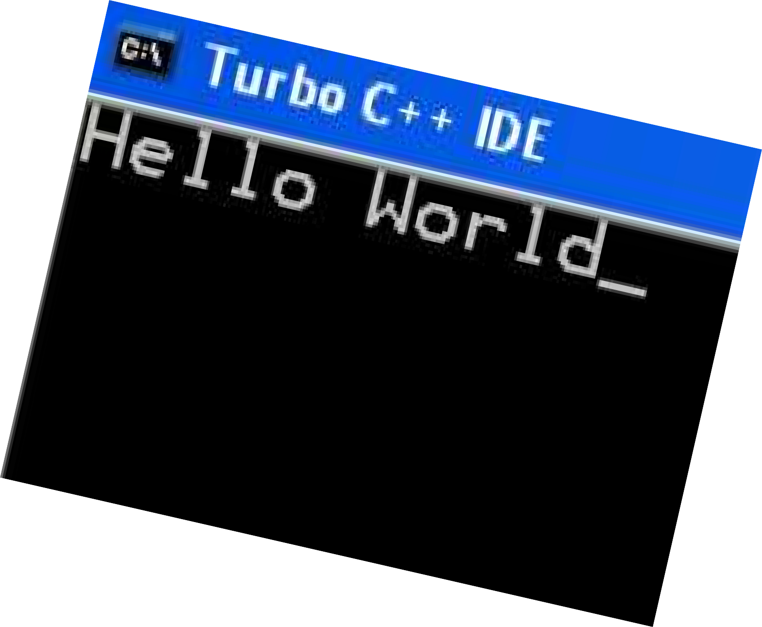
Example of “C” Program
/* HELLO.C -- Hello, world */
#include <stdio.h> Void main()
{
printf("Hello, world\n");
}

Slide 15



